Slide 1
Final Presentation
of
Edu-Right
180041203
Md. Sajid Altaf
180041204
Syed Mohammed Sartaj Ekram
180041219
Adham Arik Rahman

Slide 2
Introduction
A website bridging humanitarians with underprivileged students
Private Sponsorship Management System to prevent student dropout
A small effort to ensure education for primary level students
Broadly two users: Sponsors & Students
Admin can review the application of students

Slide 3
High Priority
User Requirements
Students applying by themselves
Proper authentication of the users
Students’ eligibility check
Smooth and robust transaction functionality

Slide 4
Medium Priority
Low Priority
User Requirements (cont’d)
Sponsors keeping track of students’ result
Update profile options for both sponsors and students
Having a user friendly interface
Students having the option to view sponsor profile
Sponsors having the option to view students profile

Slide 5
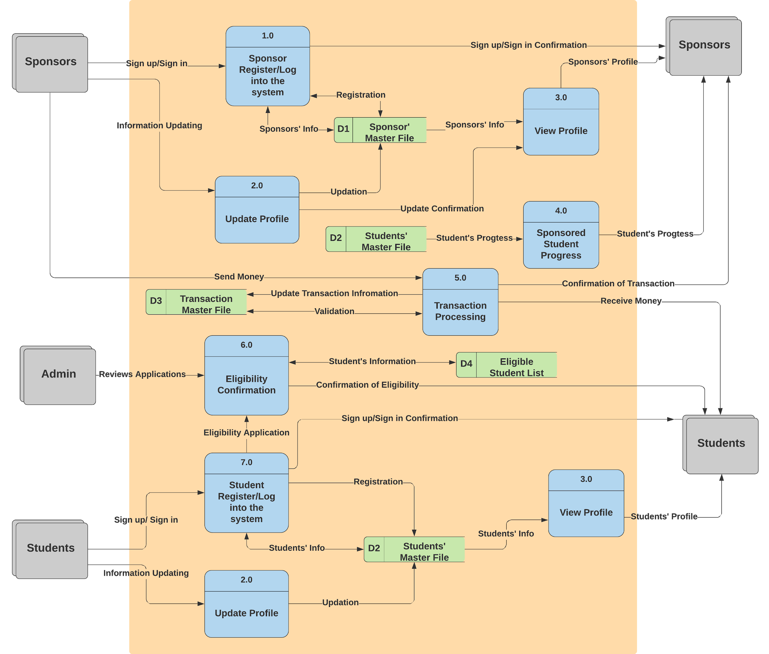
Diagram 0

Slide 6
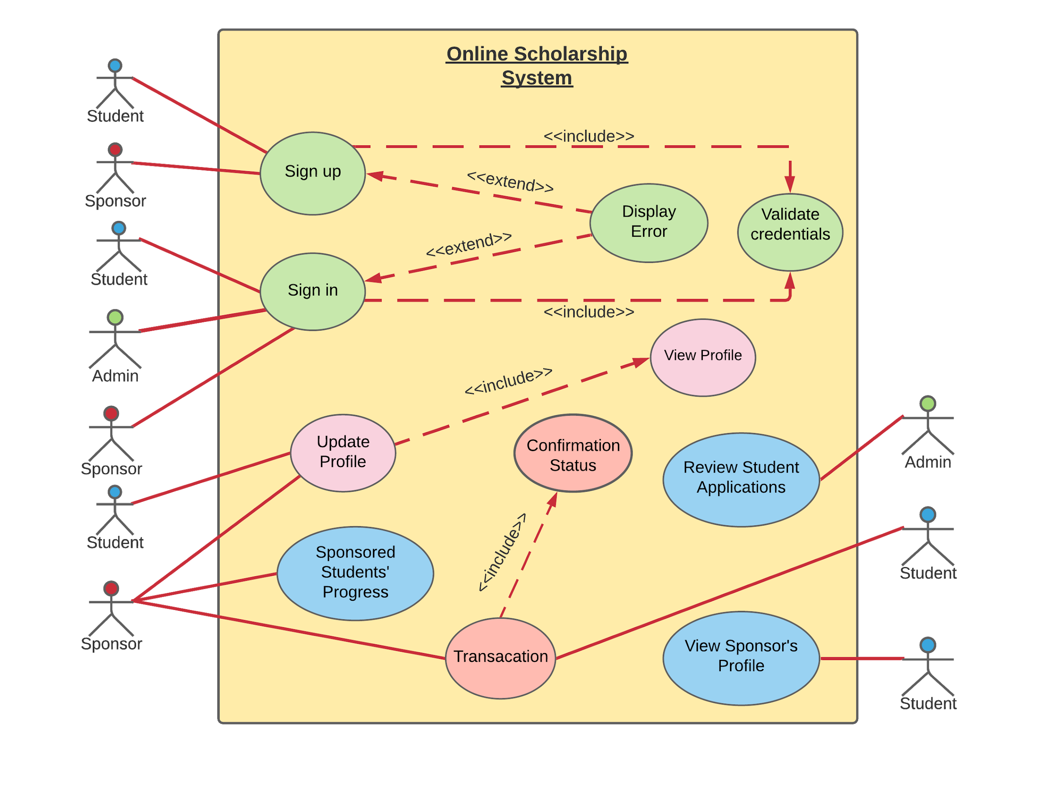
Use Case Diagram

Slide 7
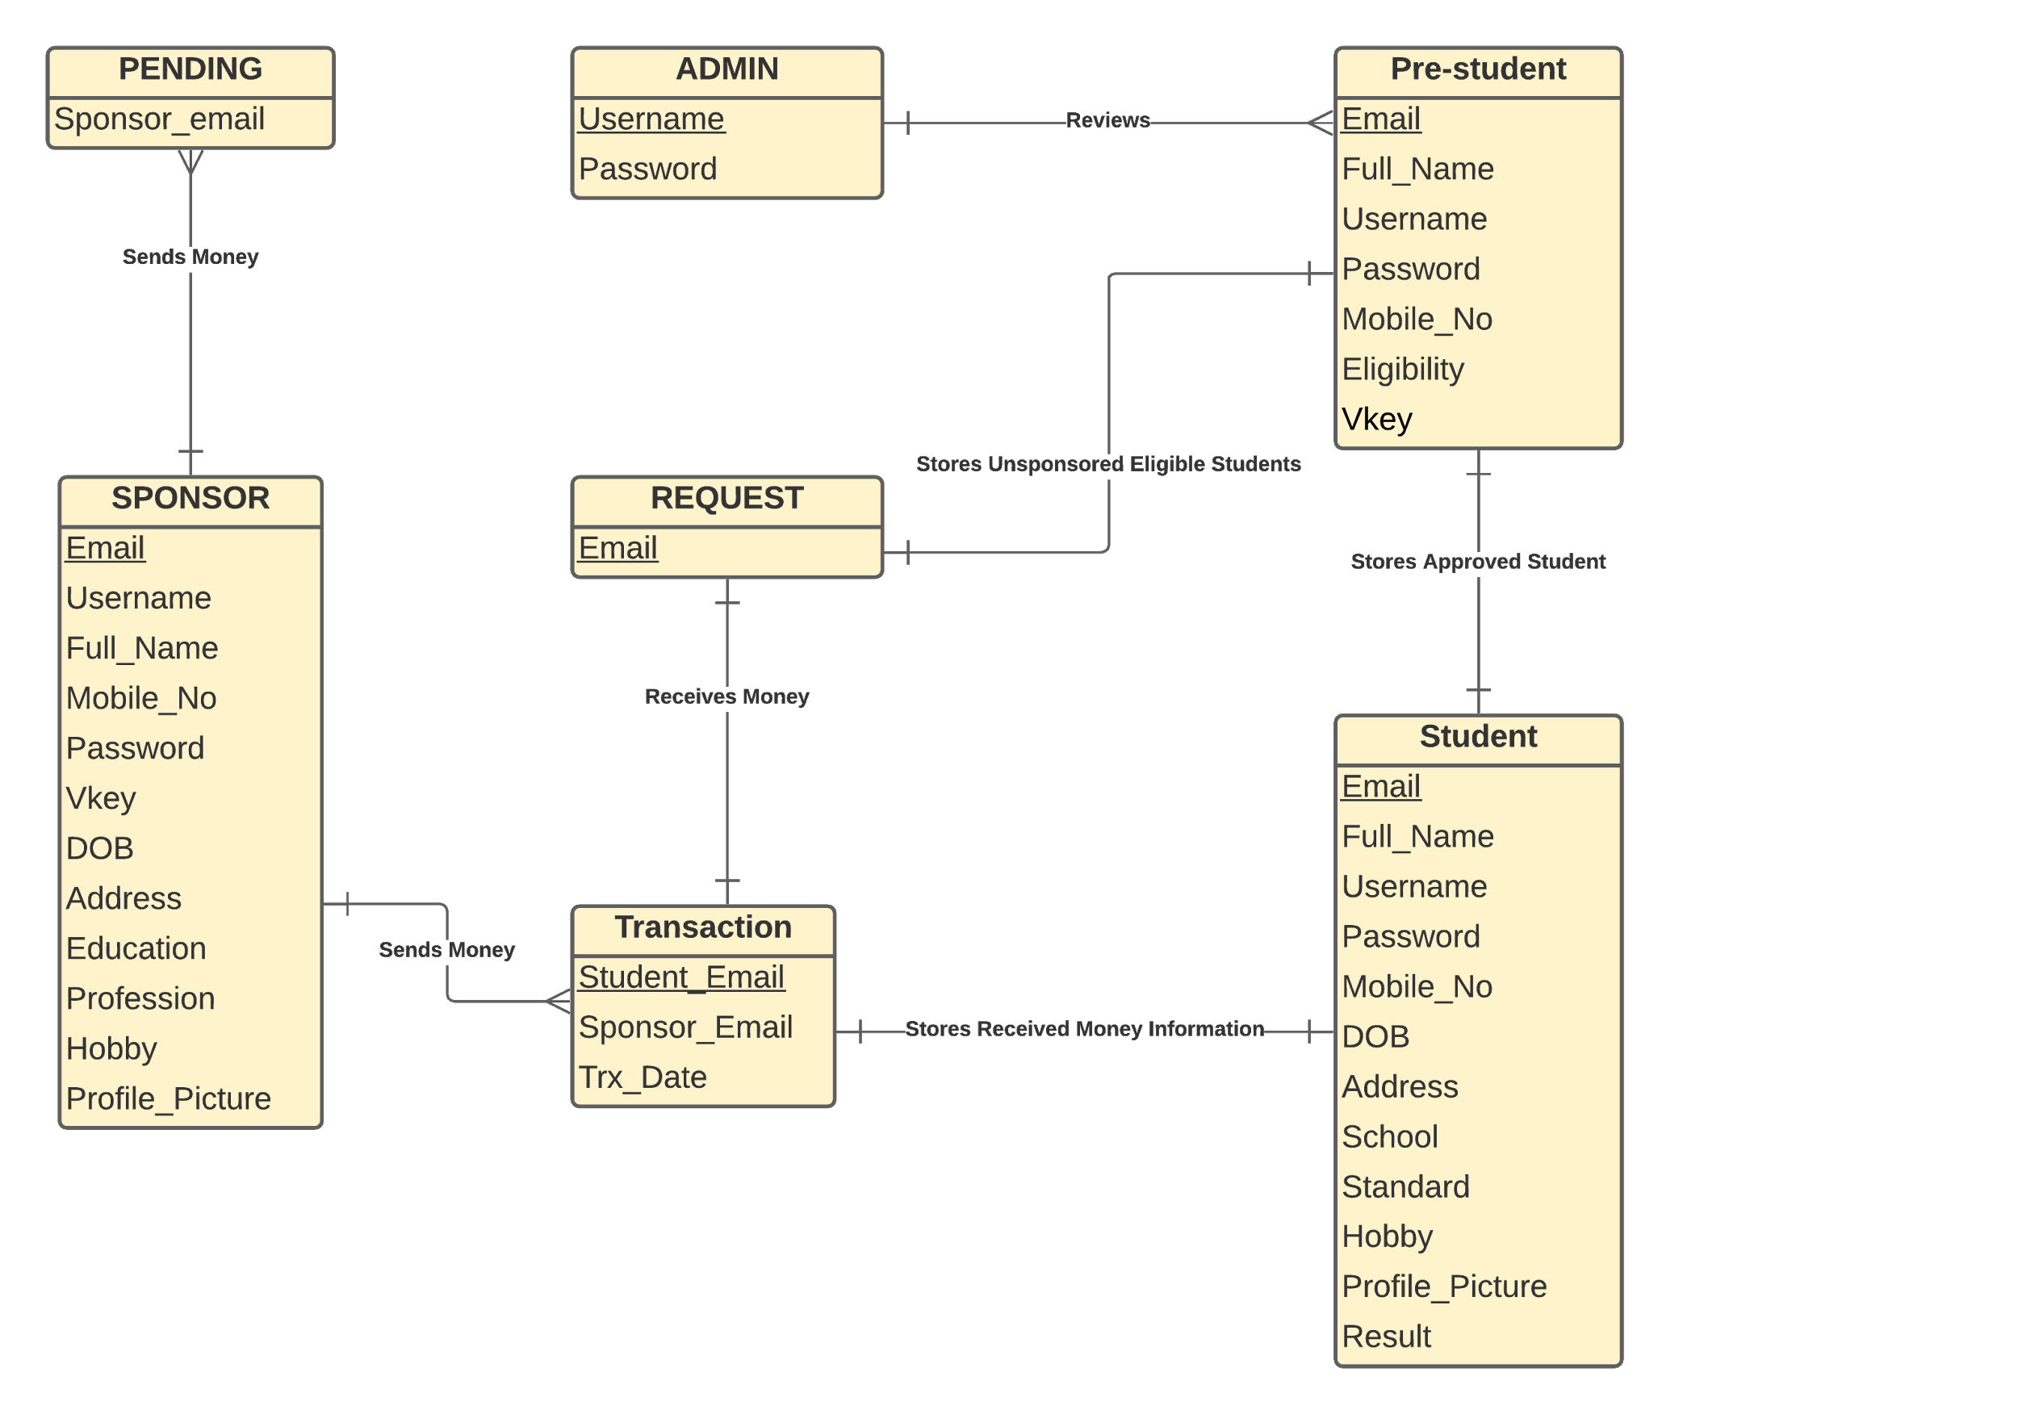
ER Diagram

Slide 8
Implemented
Features
Sign up & Sign in options
View profile options
Update profile options
Email Verification functionality
Forgot Password functionality
Send Money option for sponsors
Sponsors can view sponsored students’ profile
Students can view sponsor’s profile
Sponsors can track students’ progress
Admin profile to review the applications of students

Slide 9
Not Implemented
Features (cont’d)
Deploying the website
Student receiving money from the system
Solid eligibility check

Slide 10
Thank You

